Slide 1


DEPI
IBM-Data science professional certificate
Final project
Shirt sales forecasting and optimization
Team Members
Mohamed Adel Mohamed Hamzawi
Supervised by
Eng. Islam Adel

Slide 2
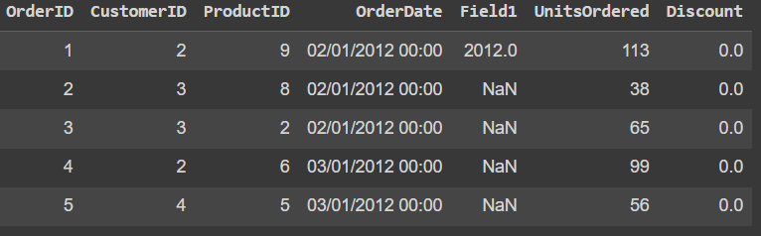
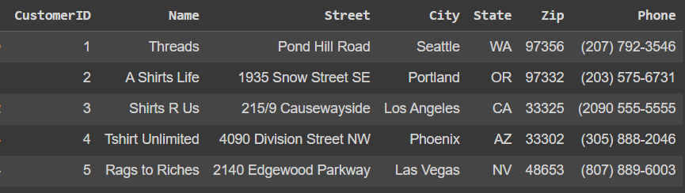
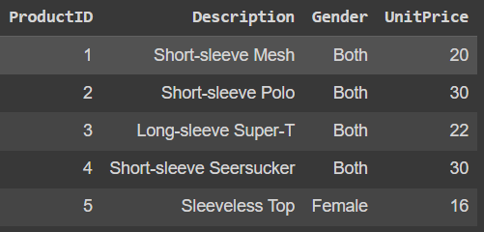
Dataset Overview
The data consists of 3 datasets: orders, products, customers

Slide 3
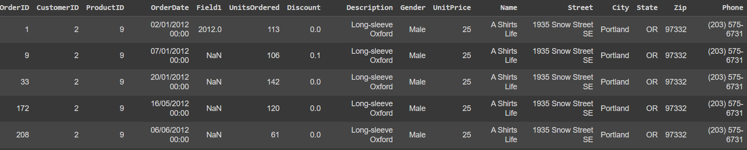
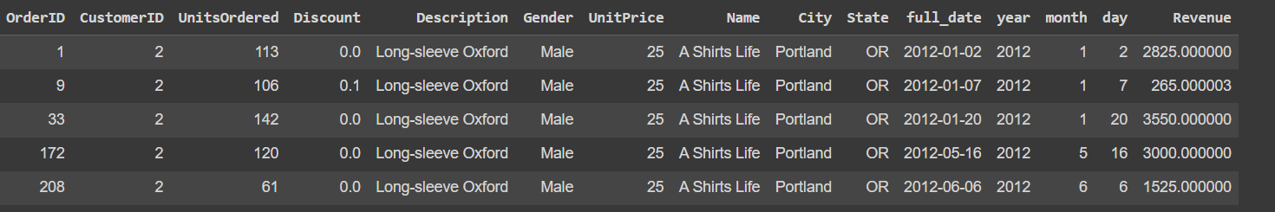
Data preprocessing
1- merge the 3 datasets into 1 sheet bases on order_id
2- Handling Missing Values, Removing Duplicates and Standardizing Formats

Slide 4
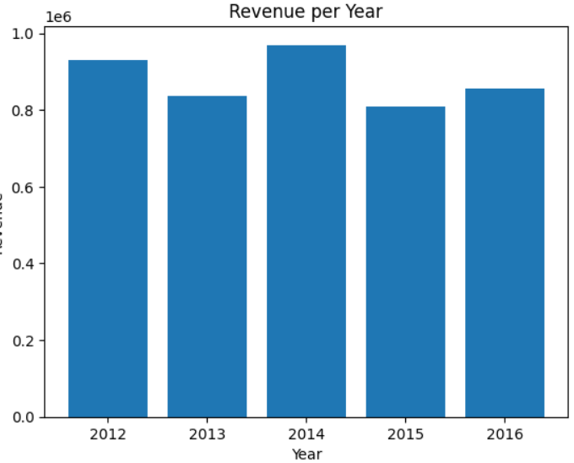
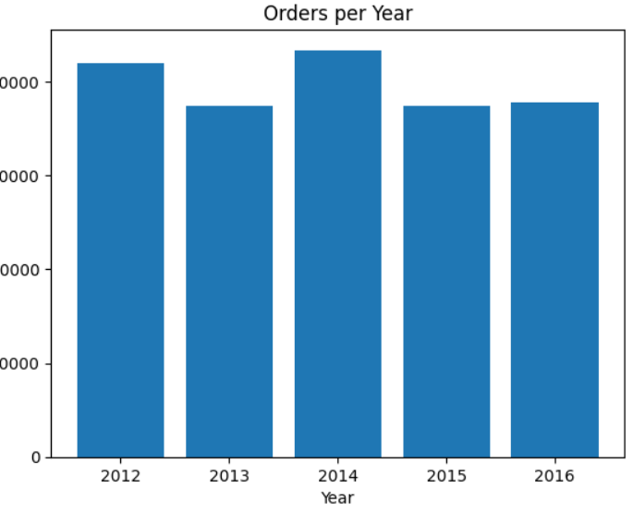
Sales Analysis
1- Revenue per year
2- Orders per year

Slide 5
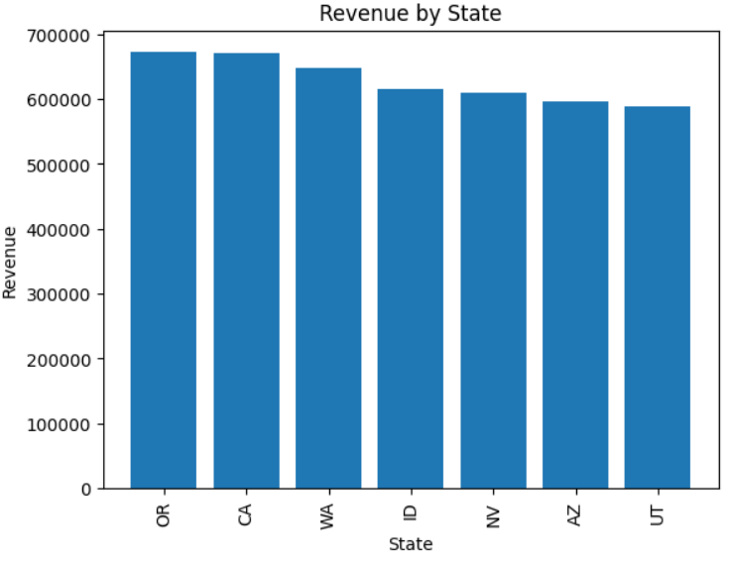
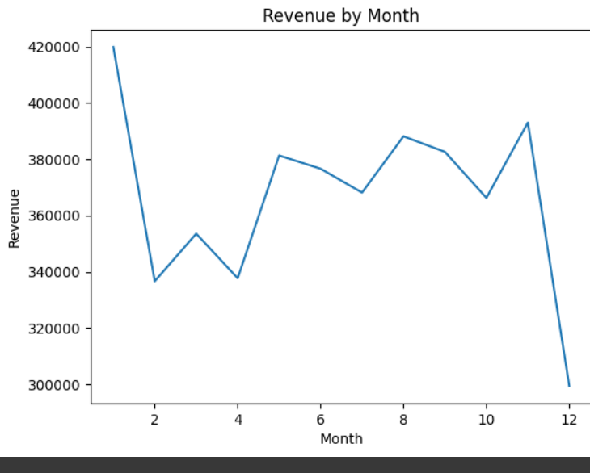
3- Revenue per state
4- Revenue per month

Slide 6
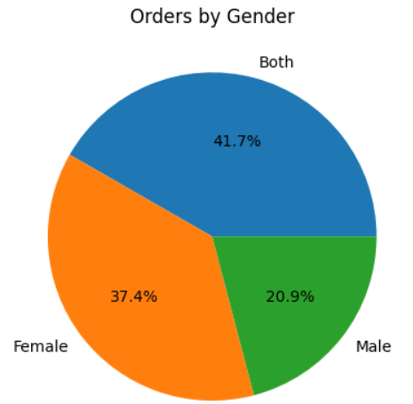
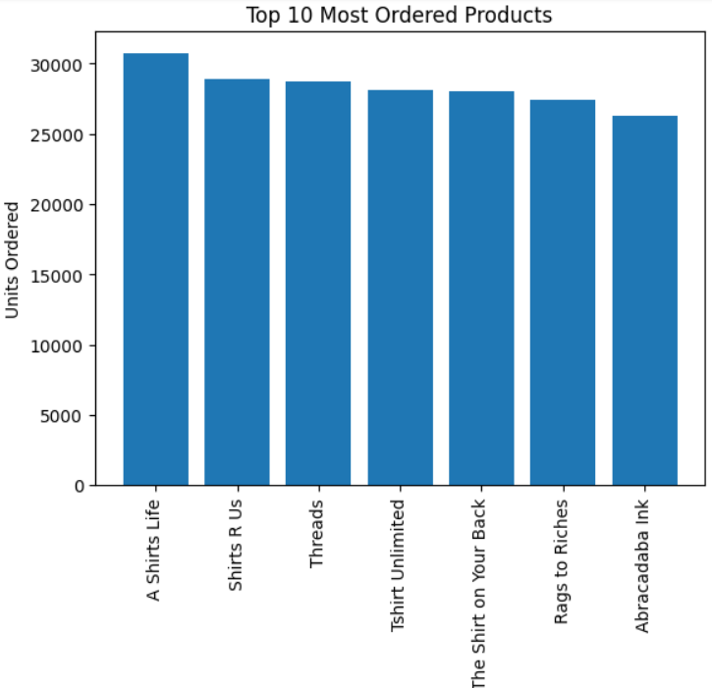
5- Orders by Gender
6- Top 10 Most Orderd products

Slide 7

Time series forecasting

Slide 8
Time series forecasting process
Dataset
Data splitting
Check data stationarity
Iterate on ARIMA with different parameters
Forecast and plot prediction vs actual

Slide 9
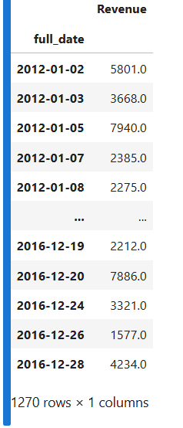
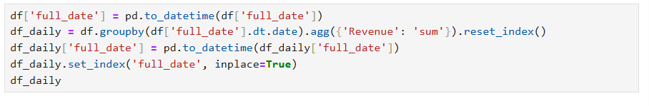
Date-indexing and NAN cells filling

Slide 10
Data splitting to train and test datasets

Slide 11
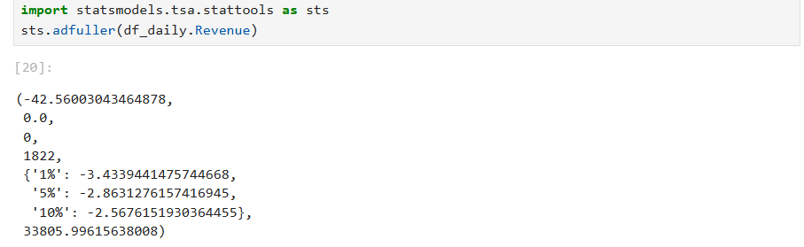
Checking stationarity using Dickey-Fuller

Slide 12
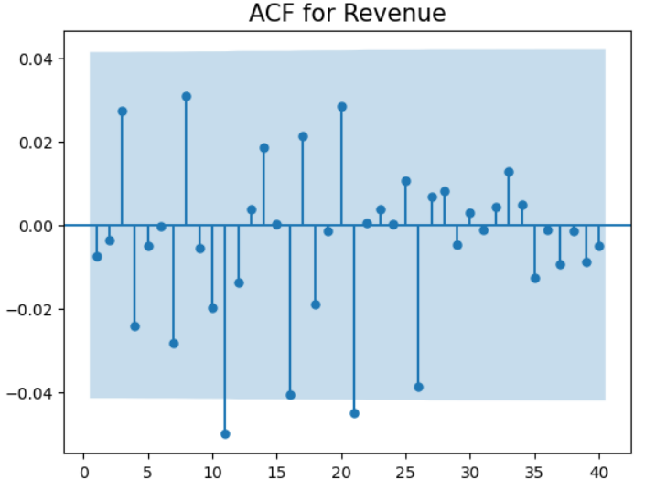
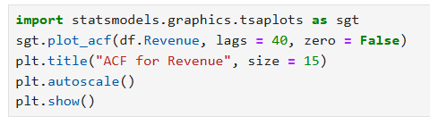
Conducting Auto-correlation function (ACF)

Slide 13
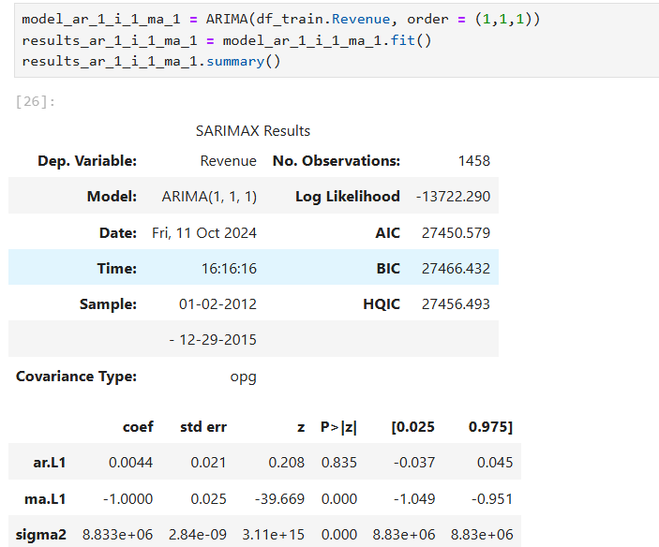
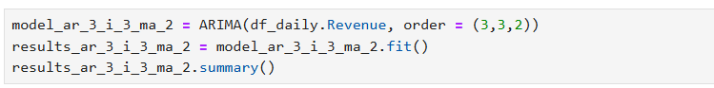
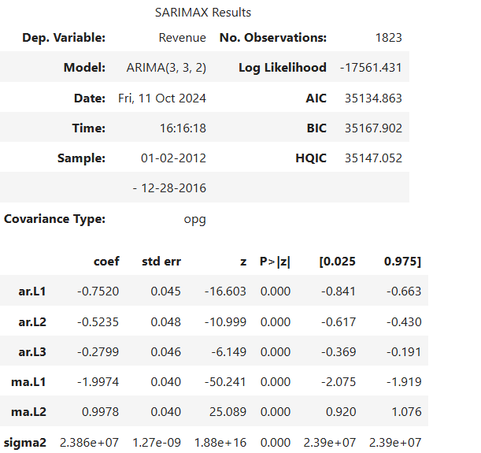
ARIMA model training iterations

Slide 14
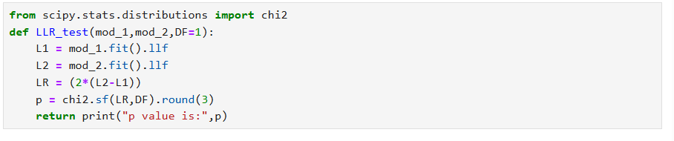
Compare models using log likely-hood
Log-likelihood function

Slide 15
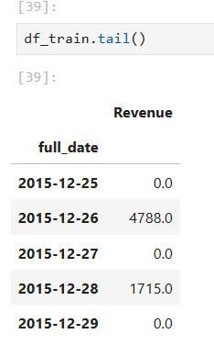
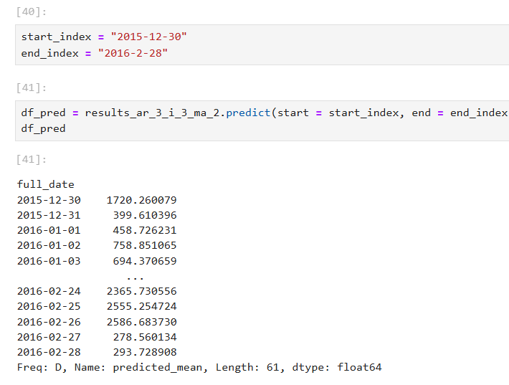
Forecasting

Slide 16
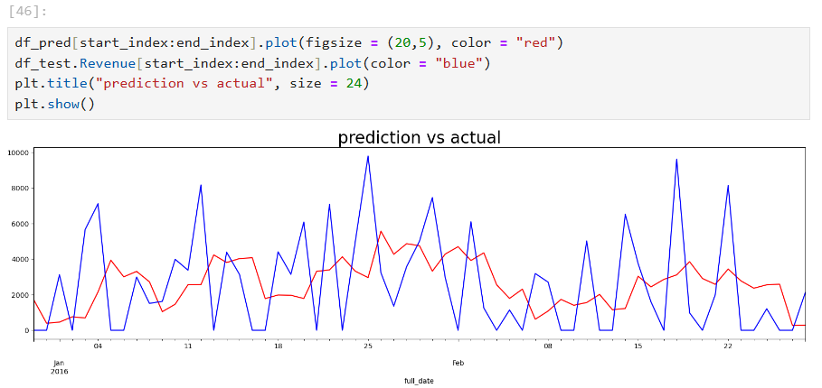
Plotting predicted vs actual output

Slide 17
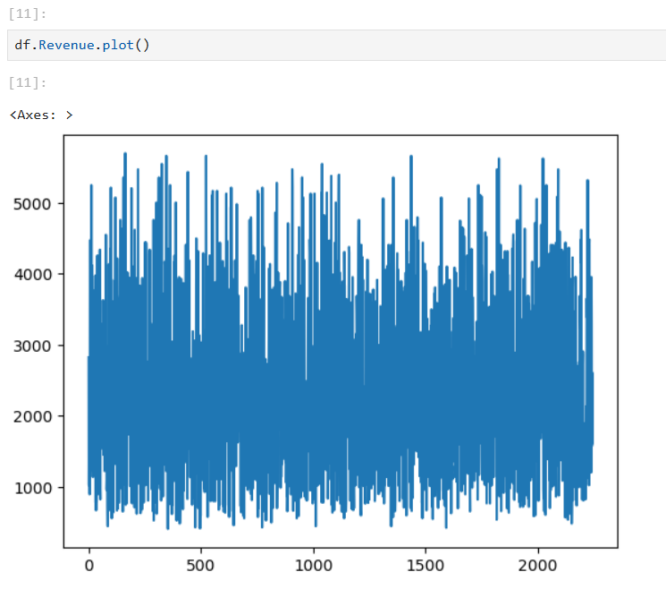
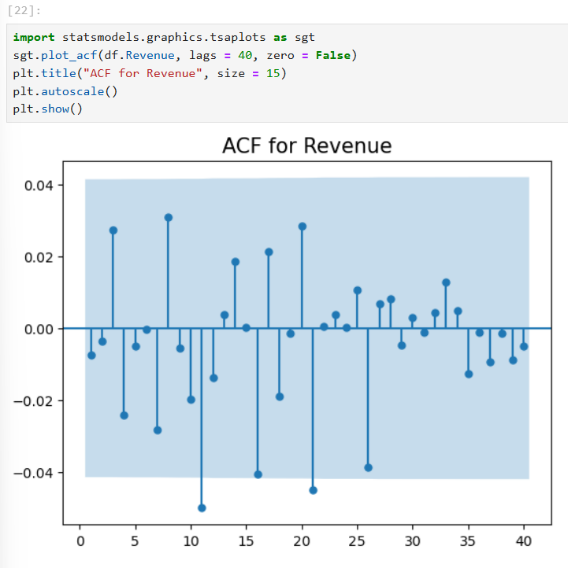
Why did the model not perform well?

Slide 18
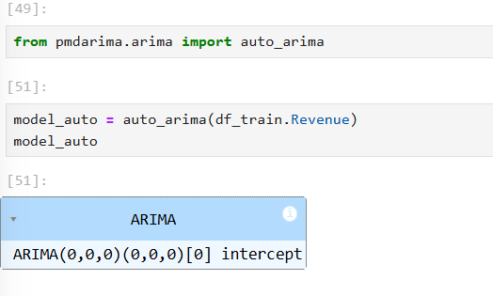
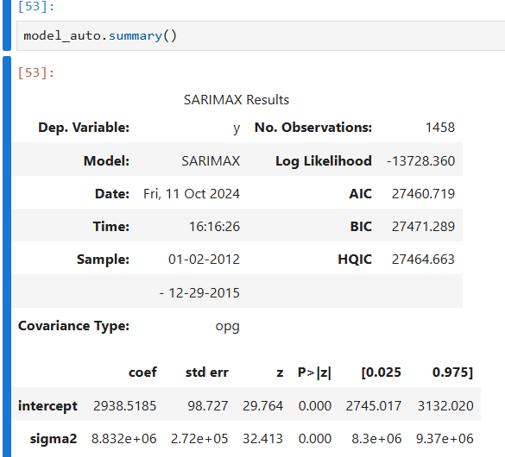
Trying Auto-ARIMA

Slide 19
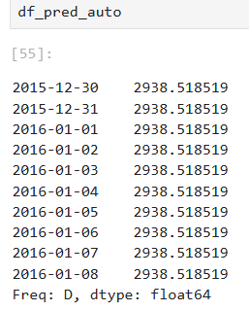
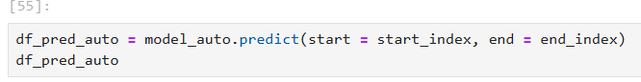
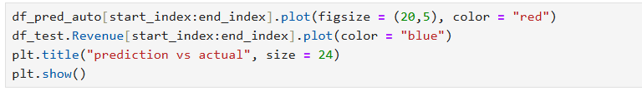
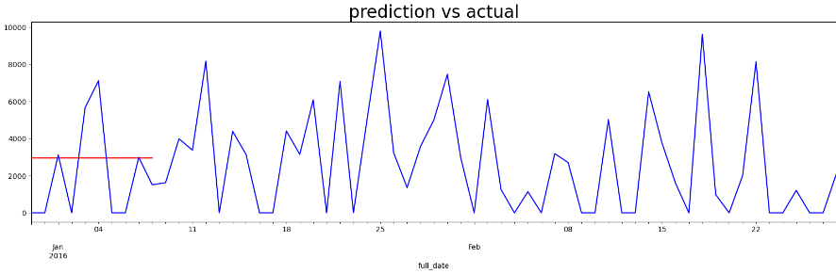
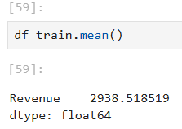
Plotting Auto-ARIMA model

Slide 20

Performance metrics

Slide 21
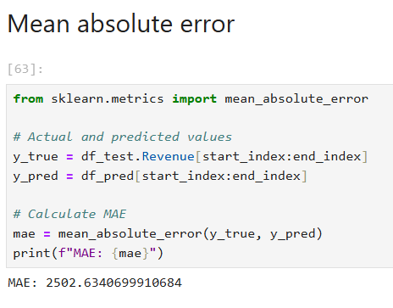
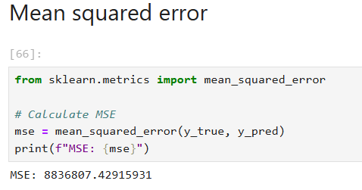
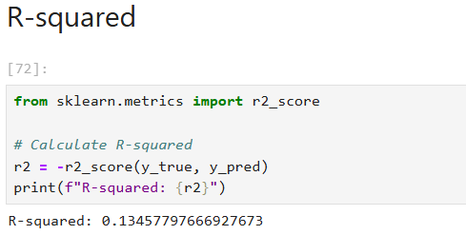
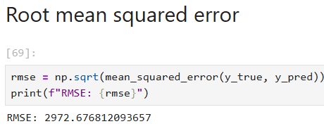
Performance metrics calculation

Slide 22
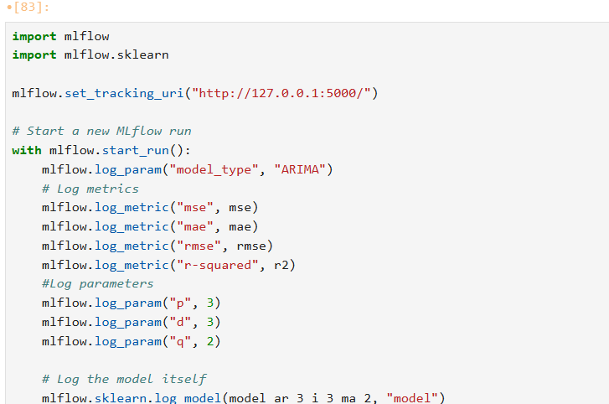
Logging model with parameters and metrics on MLFlow

Slide 23
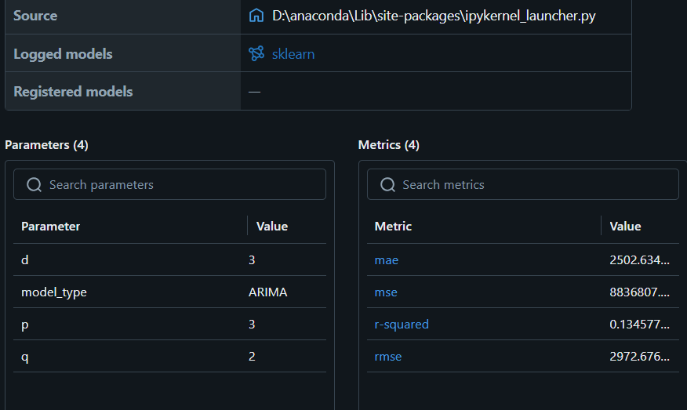
Project dashboard on MLflow

Slide 24
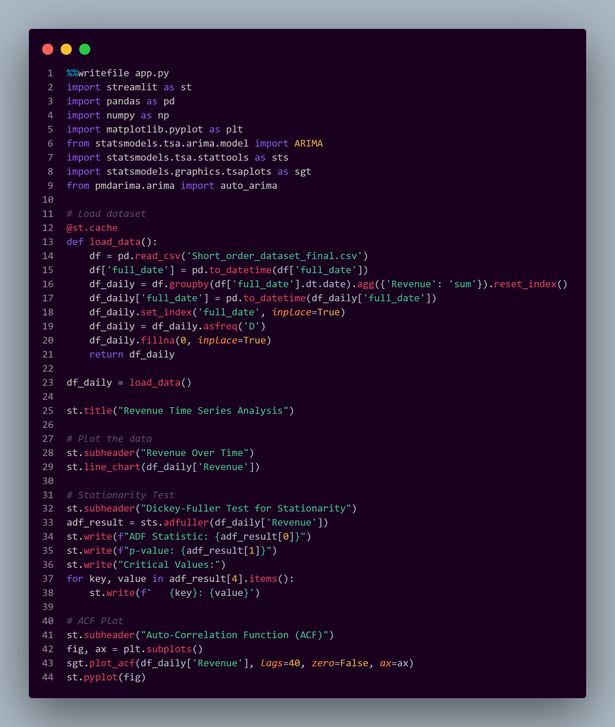
MLOPS , DEPLOYMENT AND STREAMLIT

Slide 25
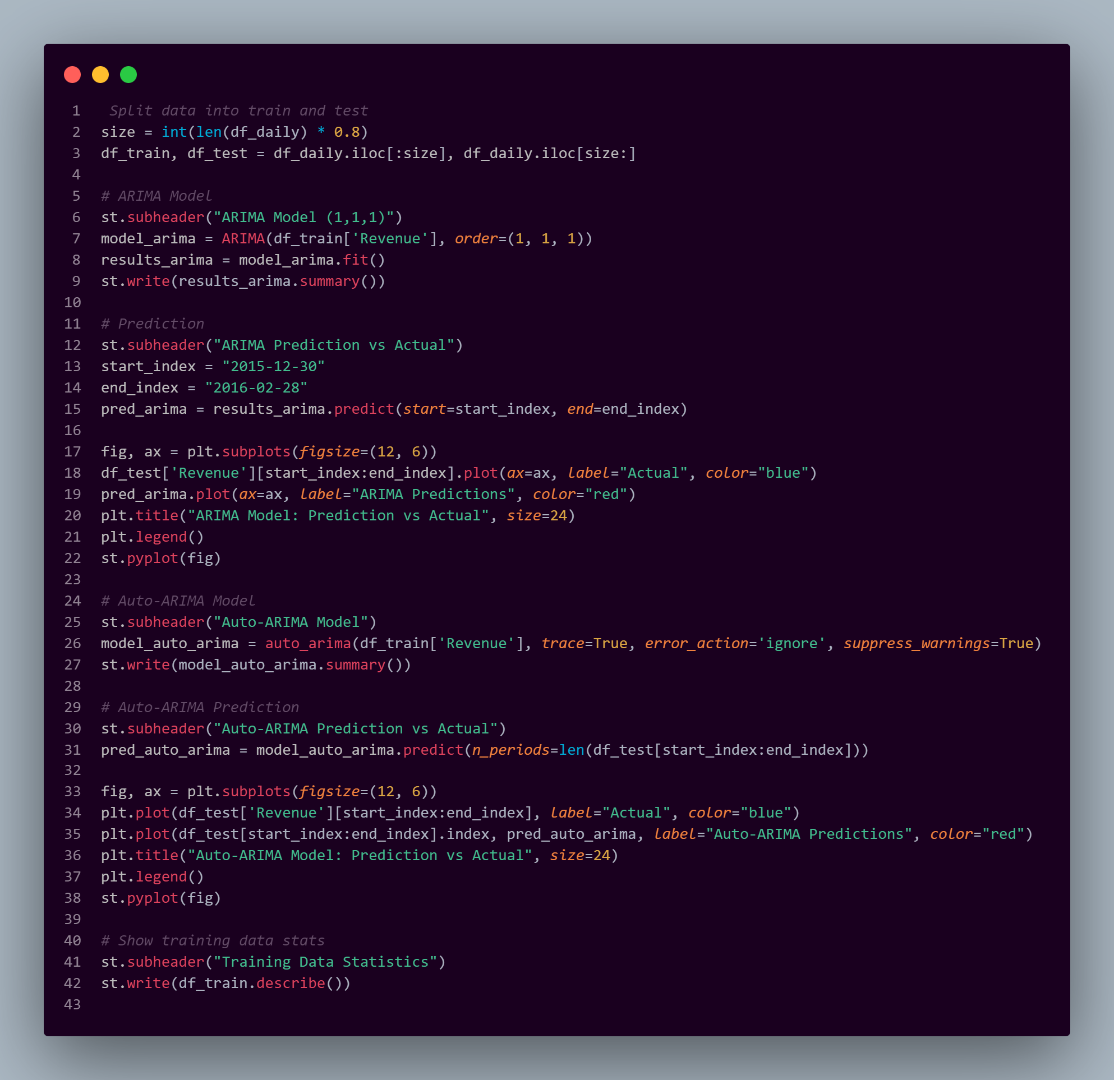

Slide 26
